Slide 1
Distributed Information Systems Spring Semester - 2020 CS-423 Time and Place Lecture: Monday 10:15-12:00 Room INF1 Exercise: Monday 12:15-13:00 Room INF1
Karl Aberer
Distributed Information Systems Laboratory

Slide 2
Goals of the Course
Understand what is a "Distributed Information System"?
e.g. Web Search Engines, Online Social Networks, etc.
Understand which are key problems relevant for DIS?
e.g. modeling, storage, indexing, retrieval, mining, recommending, integration, etc.
Master common techniques used to solve these problems
e.g. vector space retrieval, association rule mining, schema mapping etc.
Assumption: basic knowledge in databases, e.g. from CS-422 Database Systems

Slide 3
Focus of the Course
Master important Models and Algorithms for representing and processing information:
Data Science
Conceptual foundations to practically use tools and platforms for Data Science
Complementary to Applied Data Analysis by Bob West

Slide 4
Other Related Courses
In synergy with
Applied Data Analysis
Complementary to
Introduction to database systems
Database systems
Some overlaps possible with
Introduction to machine learning
Machine learning
Introduction to natural language processing
Internet analytics

Slide 5
The Course - Lecture
Lecture
standard ex cathedra lecture
but feel free to interrupt, ask questions …
Web platform: Moodle
Course notes and exercises will be published on the Web in advance
Questions using TurningPoint
Session ID: DIS2020
Messaging is enabled

Slide 6
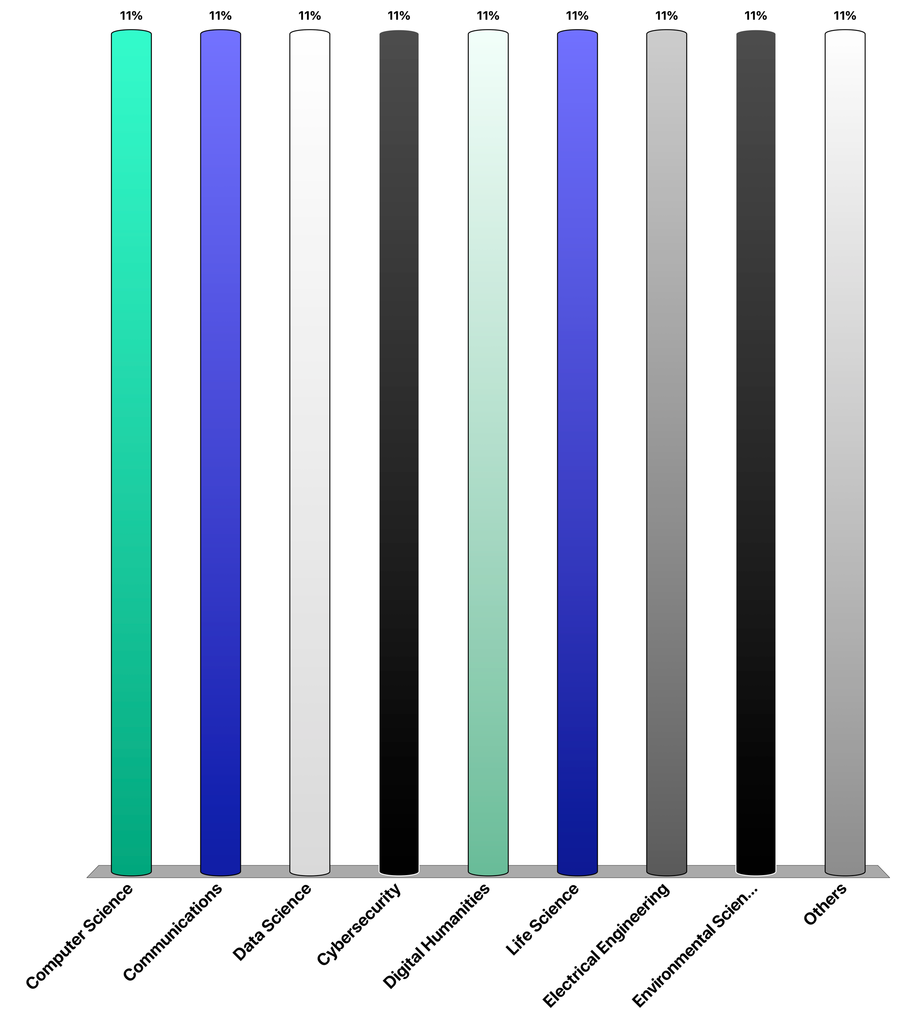
Which masters program are you from?
Computer Science
Communications
Data Science
Cybersecurity
Digital Humanities
Life Science
Electrical Engineering
Environmental Science
Others

Slide 7
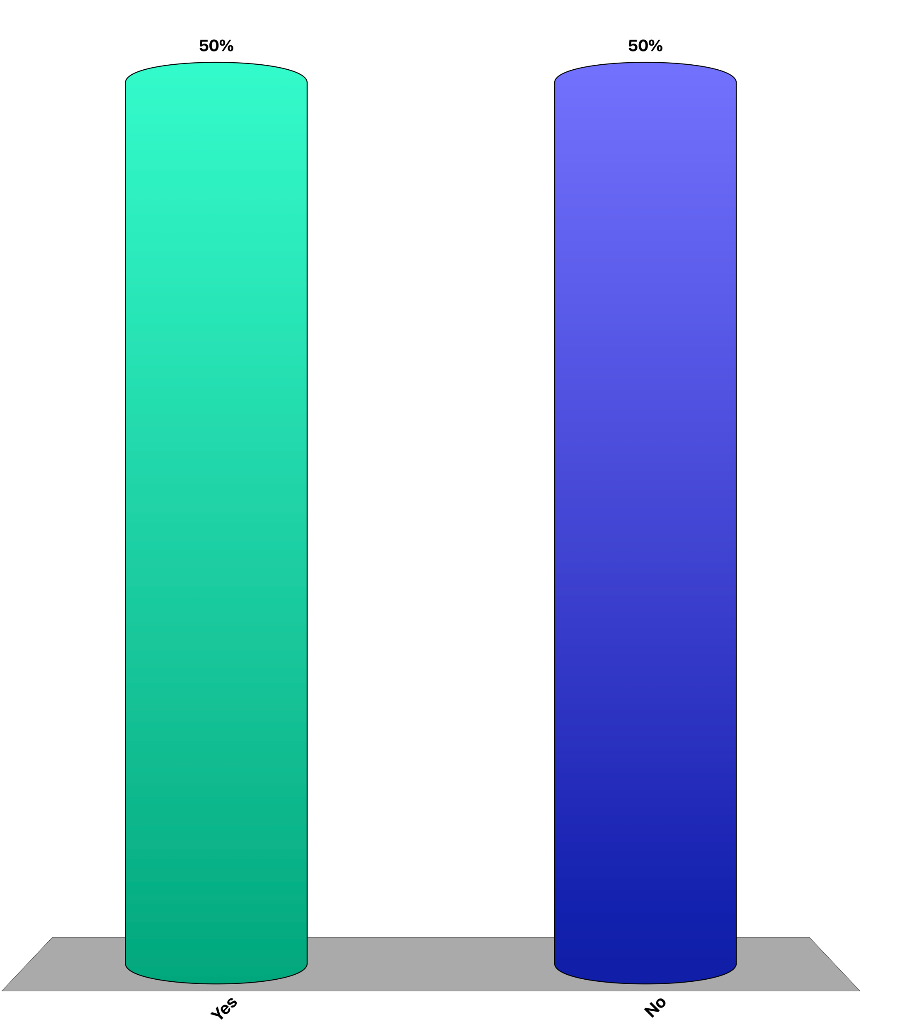
Did you take Applied Data Analysis
Yes
No

Slide 8
Exercises
Weekly exercises
2-3 problems to solve
Most problems will be (simple) programming exercises
Uses Python
Focus on understanding the techniques (not programming skills etc)
Exercises and exam questions from previous years will be made available as well

Slide 9
Continuous Control
1 programming midterm: March 16
Evaluate your programming skills (for yourself)
2 quizzes: April 20 and May 18
Multiple choice questions on the content covered during the previous weeks
All during exercise session

Slide 10
Grading
Results of continuos control will be part of grade: 25%
When you are excused (e.g. illness) the session is not counted
Final Exam: 75%
Questions similar to the question in exercises and quizzes
will assume you attended the lecture
will assume you did the exercises
examples from earlier years (exercises, exams) provided for preparation
Exam Support: Your computer will be admitted to the exam, not the Internet! Also your notes.

Slide 11
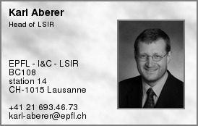
Lecturer

Slide 12
Schedule
Week | Date | Cont. Eval. | Area | Topic
1 | 17 February 2020 |  | Introduction | Distributed Information Systems - An Overview
2 | 24 February 2020 |  | Information Retrieval | Basic Text Retrieval Models
3 | 02 March 2020 |  |  | Indexing and Probabilistic Retrieval
4 | 09 March 2020 |  |  | Advanced Retrieval Methods
5 | 16 March 2020 | Prog. Midterm |  | Relevance Feedback and Link-based Retrieval
6 | 23 March 2020 |  | Data Mining | Frequent Itemset Mining
7 | 30 March2020 |  |  | Clustering and Classification
8 | 06 April 2020 |  |  | Classification Methodology
9 | 13 April 2020 |  |  | Holiday
10 | 20 April 2020 | Quiz |  | Document Classification and Recommender
11 | 27 April2020 |  |  | Social network mining
12 | 04 May 2020 |  | From Documents to Knowledge | Semantic Web
13 | 11 May 2020 |  |  | Entity and Information Extraction
14 | 18 May 2020 | Quiz |  | Data Integration
15 | 25 May 2020 |  |  | Knowledge Graphs

Slide 13
Organizational Info
Moodle
http://moodle.epfl.ch/course/view.php?id=4051
Lecturers
Prof. Karl Aberer karl.aberer@epfl.ch BC 108
Assistants
Chi Thang Duong thang.duong@epfl.ch BC 130
Tugrulcan Elmas tugrulcan.elmas@epfl.ch INN 134
Smeros Panayiotis panayiotis.smeros@epfl.ch BC 142
Jeremie Rappaz jeremie.rappaz@epfl.ch INM 035

Slide 14
References
Parts of the course are based on the following text books
Ricardo Baeza-Yates, Berthier Ribeiro-Neto, Modern Information Retrieval (Acm Press Series), Addison Wesley, 1999.
Jiawei Han, Data Mining: concepts and techniques, Morgan Kaufman, 2000.
Christopher D. Manning, Prabhakar Raghavan and Hinrich Schütze, Introduction to Information Retrieval, Cambridge University Press. 2008.
J Leskovec, A Rajaraman, JD Ullman, Mining of Massive Datasets, 2014.
Further references to the literature will be given during the lecture

Slide 15
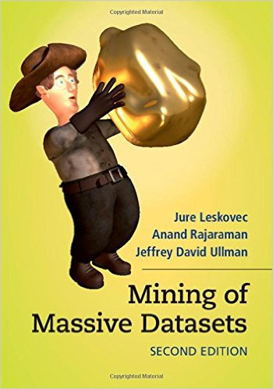
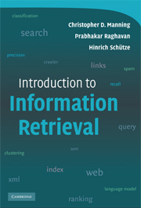
Free books
mmds.org
http://nlp.stanford.edu/IR-book/

Slide 16
Exam Date

